Slide 1

DriverPass System Analysis
Charles Campbell
15 December 2024

Slide 2

System Requirements
Functional:
Customers/Secretaries Scheduling Driving Lesson
Choosing & Purchasing of Learning Packages on DriverPass
Non-Functional:
High Performance (instant or small load times on website)
Reliable Connection (website is constantly accessible 24/7)
Notes:
Functional Requirements are often described as “need to have” in order for the proposed system to achieve the intended goal. In the case of DriverPass, that goal is to have a way for individuals to train and practice up-to-date rules and regulations in order to pass tests at the DMV. Two major functional requirements that would be needed is: 1. the ability for customers/secretaries to make appointments for driving lessons, which allows customers to practice and be more prepared for the real test at the DMV; and 2. proper choosing and purchasing of learning package options for customers. DriverPass requires potential driving students to pick a learning package to attend the driving lessons; these two requirements are essential for students to achieve the goal of learning to improve their driving skills.
The non-functional requirements aren’t as essential, but still provide substantial value to a product, to ensure that it doesn’t just achieve the end goal but makes sure it’s both seamless and provide quality. For DriverPass, two non-functional conditions would be: 1. high performance (small load time for the web based system to load), and 2. reliability (constant connection/website doesn’t go down/constantly accessible). These requirements would highly improve the quality of the system, but aren’t as essential to delivering learning resources to driving students like the functional requirements. They can be worked on in the next step for further improving the product after launch.

Slide 3
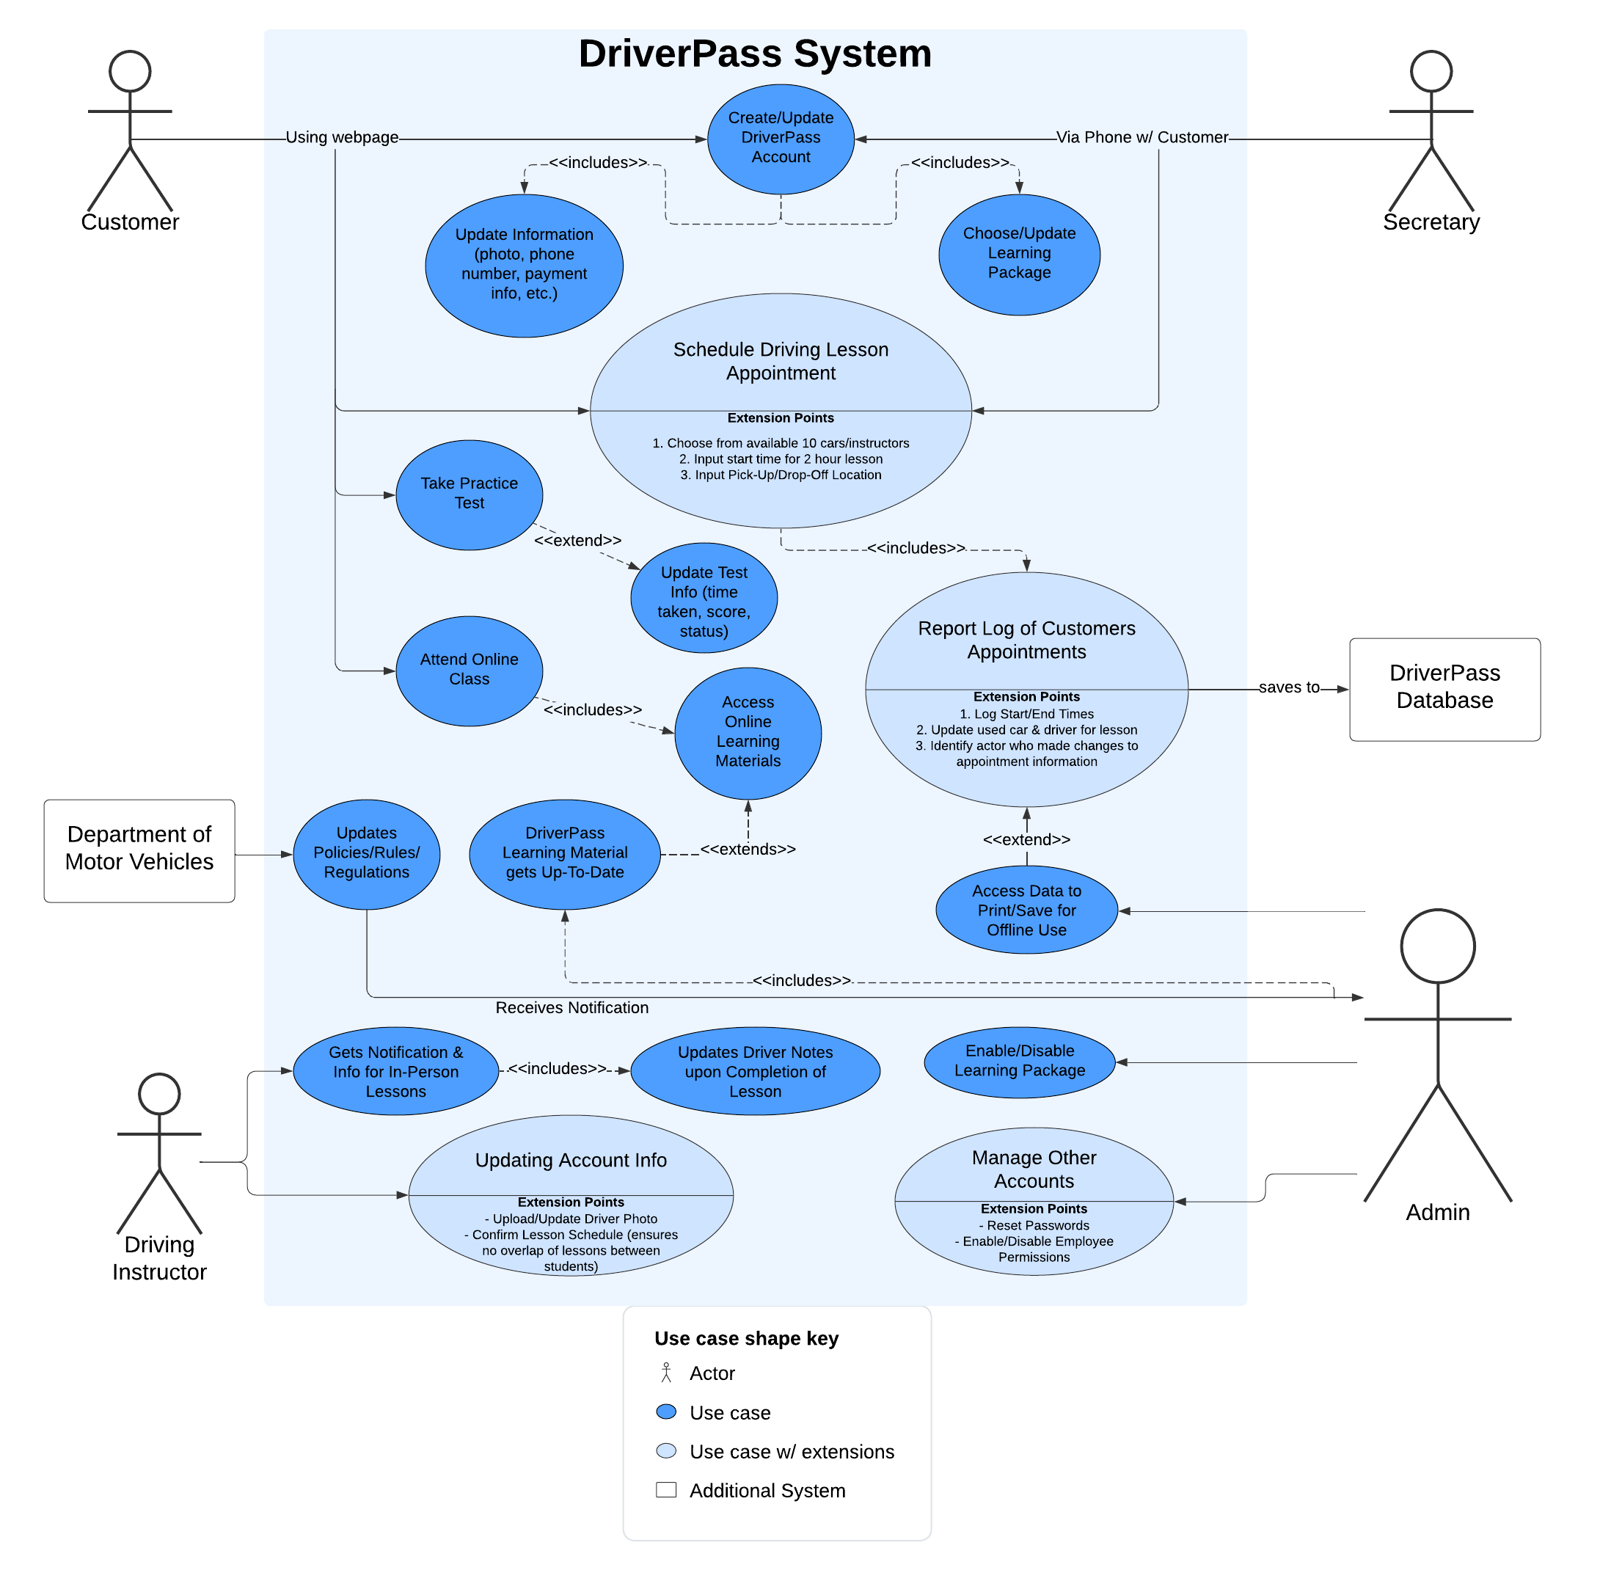
Use Case Diagram
Notes:
This diagram identifies the prominent people who will utilize DriverPass. These people include the customers, as well as the employees: the secretary, driving instructors, and the admins. Additionally, the DriverPass Database and the DMV play a role in making sure everything runs smoothly for DriverPass.
Each individual is linked to a specific action. For example, customers and the secretary can set up a driving lesson appointment, which details the car used, drop-off & pick-up location, as well as when the best start time will be. This information flows to the DriverPass Database, where Admins and Instructors can view and edit as needed so the customer can have a successful lesson. Another example, the Admin can be seen to receive a notification from the DMV on new resources, which they can then update in the database to help students have the most up-to-date resources to pass practice tests and succeed in their driving lessons.
These are just a few examples to show how all the necessary requirements that were laid out in the initial interview have been accounted for. This graphic represents the culmination of a fully functioning DriverPass flow of actions made to ensure that students can get resources and driving training to help them succeed at the final tests at the DMV.

Slide 4
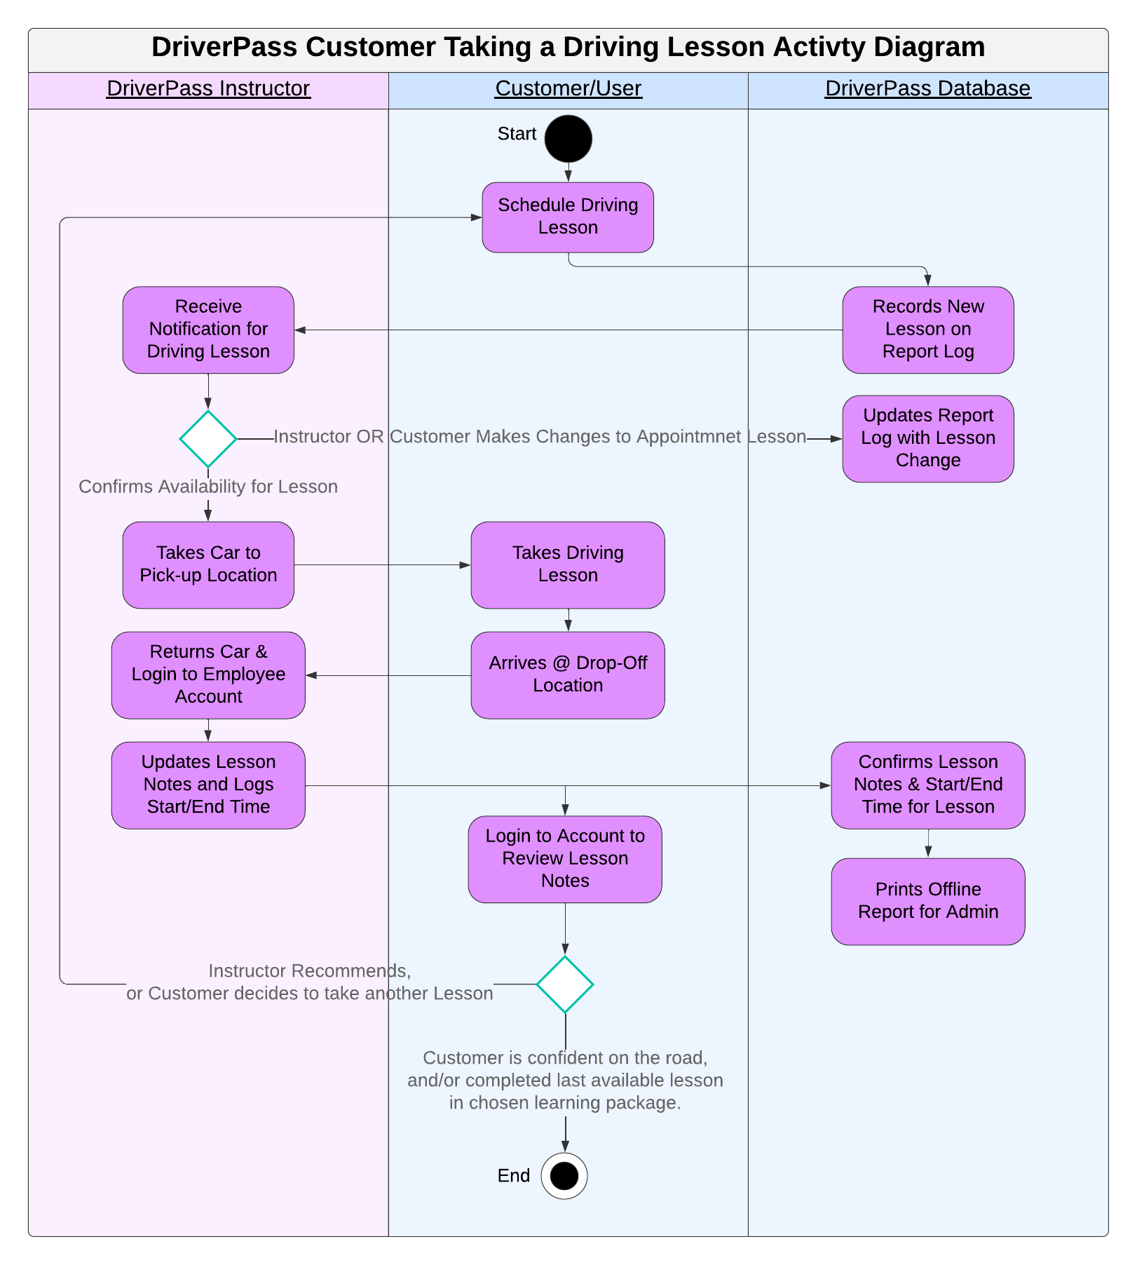
Activity Diagram
Notes:
Diagrams like these can be a great help to ensure that DriverPass actions are complete from start to finish. This follows the breakdown of every step in the activity of a customer taking a driving lesson through DriverPass. From the start when the customer schedules the appointment, to the DriverPass database being updated to store the information and accessible for admins to view the creation/changes being made, and the instructor helping confirm and attend the driving lesson all the way to returning the lesson car and adding notes for the customer to improve. This follows DriverPass’s vision to help driving students learn and improve so they can eventually pass the DMV test.
This diagram would show just one of the many instance of DriverPass’s needs being addressed in the system. Developers utilize this visualization tool to not only help communicate how the task gets accomplished, but also is a clean blueprint to ensure that all the steps are considered and get translated into the end product for a highly efficient and high quality system that meets both the company’s and customer’s needs.

Slide 5
Security
Authentication through login (username/password) for everyone using DriverPass, even administration
Different levels of authorization to overall system and data tied to specific roles
HTTPS (web based) encryption is a strong and modern security protocol, and DriverPass’s can grow in security with other methods
Notes:
Security is paramount when both having company data and customer information saved on a web based platform. DriverPass is no different, and ensuring that anyone who accesses it through authetication methods like requiring a username and password helps keep everything secure.
Additionally, the design of DriverPass allows for each person to have limited access to information that is only essential to them. These ‘roles’ are managed by the I.T. manager and administratives, while individuals like customers and instructors can only modify small things in their respective areas. This keeps data private and establishes a security hierarchy in the system.
The internet itself has grown in security, and websites that have the “HTTPS” attached to the URL are tightly encrypted and safer than most. DriverPass can potentially grow in security given the needs of the management, with additions like file encryption (securing learning resources) or even adding one-time passwords can greatly increase the security of the product and deter cyber-threats from occuring. Security should regularly be assessed and reviewed to ensure that there won’t be any leaks of private data, company or customer wise.

Slide 6
System Limitations
Electrical Outages can limit access to DriverPass via internet
Security limitations upon relying solely on Cloud-based system provider
Limitations in project’s features between different devices/browsers
Limit on data storage and accessing information, with growth of customers
Budget limitations when paying for 3rd party Cloud services/hosting of website
Notes:
With any system, even DriverPass, there comes certain limitations. With a web based product like this, we have to consider that at times either the company or the customer will experience electrical outages which will limit their access to DriverPass. Internet outages from providers can also occur, which can complicate the completion of project’s functions.
While a Cloud based system can have high security, nothing is completely secure on the world wide web. Hackers and criminals will find exploits and are persistent in finding ways to intrude on private information. Security on data can be limited if it’s primarily focused in the cloud.
Potential growth of customers or infrastructure limitations can greatly limit the storage and access of data for the system. Ensuring that the hardware and software can match the demands of DriverPass’s customers needs be considered to deliver a seamless experience, and doesn’t limit a customers or employees ability to access learning resources or other information.
Whenever one hosts or develops a web-based and/or cloud-based system, the budget should be considered. Paying for the 3rd party web hosting and/or cloud service can vary between brands/providers and can even change drastically over time. Research and careful insight on the best service can greatly help reduce the limitations of the budget and overall cost to keep DriverPass running for customers and employees to use.

